Slide 1


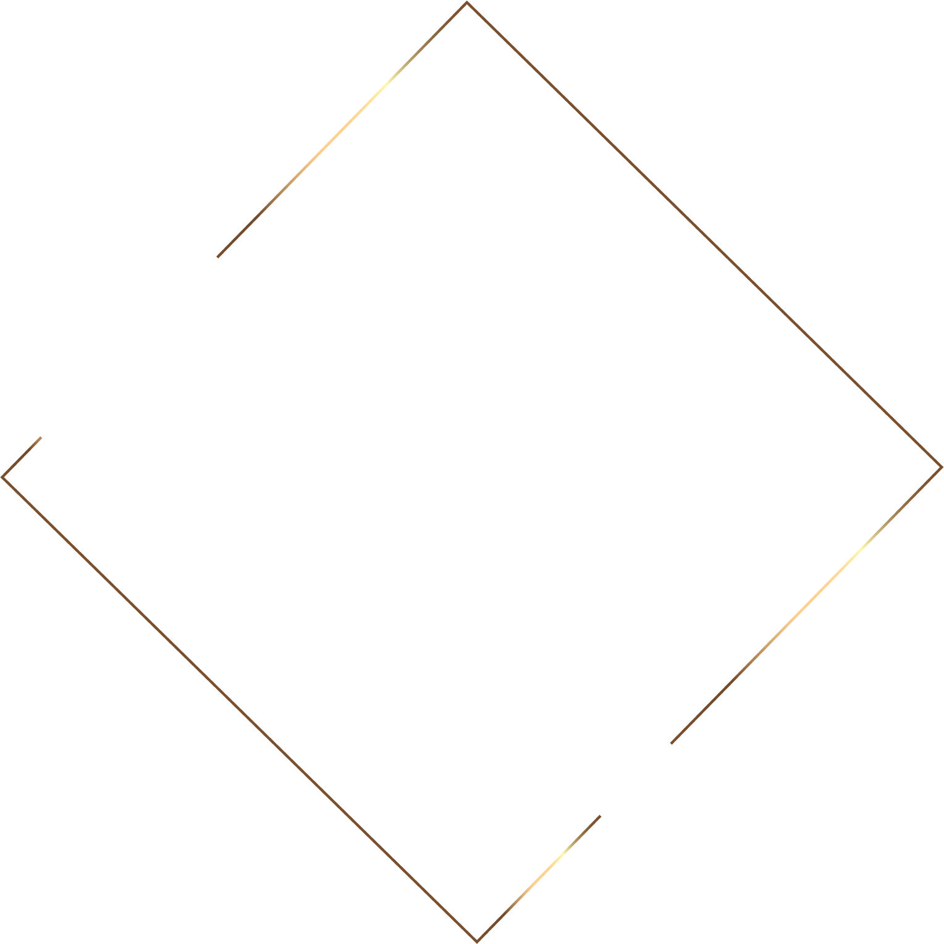



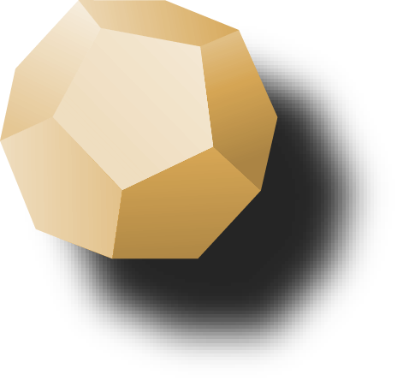
Deep learning based recognition of ocular disease in Fundus images.

Slide 2
ABSTRACT
The aim of this project is to develop a deep learning model for the recognition of ocular diseases in fundus images, specifically glaucoma, cataract, and diabetic retinopathy.
The project utilizes a dataset of fundus images that are labeled with disease categories to train a convolutional neural network (CNN) model.
The CNN model consists of four convolutional layers, four max-pooling layers, and two fully connected layers, with ReLU activation used in the convolutional layers.
Image augmentation is used to increase the size of the dataset and reduce overfitting.

Slide 3
ABSTRACT
The model is trained and validated using the training and testing datasets, respectively, with early stopping used to prevent overfitting.
The performance of the model is evaluated using metrics such as accuracy, precision, recall, and F1 score.
The results show that the model achieves a high level of accuracy in recognizing the three ocular diseases in the fundus images, demonstrating the potential for deep learning models to aid in the diagnosis of ocular diseases.

Slide 4
LITERATURE SURVEY
S. No | Name of the paper | Objectives | Pros | Cons
1. | T. Guergueb and M. A. Akhloufi. (2021). “Ocular diseases detection using recent deep learning techniques”, in Proceedings of the Annual Int. Conf. IEEE Eng Med Biol Soc, pp. 3336–3339, IEEE, Mexico | Deep learning model has the potential to be used as a diagnostic tool for ocular diseases, and it could help in the early detection and treatment of these diseases. | The use of deep learning techniques, particularly convolutional neural networks, is a powerful tool for image analysis and has been shown to be effective in the detection of ocular diseases. | Does not discuss the potential ethical implications of using a deep learning model for medical diagnosis
2. | Caroline Ka Lin Chee, Patrick A. Santiago, Gopal Lingam, Mandeep Singh. (2014). “Application of Ocular Fundus Photography and Angiography”, Ophthalmological Imaging and Applications,154–175.. | Overview of the principles, techniques, and clinical applications of ocular fundus photography and angiography, which can be useful for ophthalmologists and imaging specialists. | Overview of ocular fundus photography and angiography, including the principles, techniques, and clinical applications. | May not have undergone the same level of peer-review as a journal article, which could affect the reliability and accuracy of the information presented.

Slide 5
S. No | Name of the paper | Objectives | Pros | Cons
3. | Y. Elloumi, M. Akil, and H. Boudegga. (2019). “Ocular diseases diagnosis in fundus images using a deep learning: approaches, tools and performance evaluation,” in Proc. Real-Time Image Processing and Deep learning. 109960T, Maryland, USA. | The proposed model shows promising results, and the authors provide detailed information on the architecture and implementation of the model, which can be useful for other researchers who are working in this field. | Presents a novel deep learning approach for the diagnosis of ocular diseases in fundus images, which can have significant clinical applications. | Focuses only on the use of deep learning techniques for the diagnosis of ocular diseases in fundus images and does not consider other imaging modalities or diagnostic tools.
4. | Borgen, P. Bours, and S. D. Wolthusen. (2009) “Simulating the Influences of Aging and Ocular Disease on Biometric Recognition Performance,” International Conference on Biometrics 2009, LNCS 5558, vol. 8(8),pp. 857–867. | Provides some interesting insights into the potential impact of aging and ocular disease on biometric recognition performance, its limitations mean that further research is needed to fully understand these effects. | Provides a detailed description of a simulation study that investigates the effects of aging and ocular disease on biometric recognition performance. | The simulation study is limited to facial recognition systems and may not be generalizable to other biometric modalities or systems.

Slide 6
S. No | Name of the paper | Objectives | Pros | Cons
5. | Li, N., Li, T., Hu, C., Wang, K., & Kang, H. (2021). “A Benchmark of Ocular Disease Intelligent Recognition: One Shot for Multi-disease Detection. Benchmarking, Measuring, and Optimizing”, 177–193. https://doi.org/10.1007/978-3-030-71058-3_11. | The proposed model shows promising results, and the authors provide detailed information on the architecture and implementation of the model, which can be useful for other researchers who are working in this field. | Presents a novel deep learning approach for the diagnosis of ocular diseases in fundus images, which can have significant clinical applications. | Focuses only on the use of deep learning techniques for the diagnosis of ocular diseases in fundus images and does not consider other imaging modalities or diagnostic tools.
6. | Miranda, E., Aryuni, M., & Irwansyah, E. (2016). “A survey of medical image classification techniques”, In 2016 International Conference on Information Management and Technology (ICIMTech) (pp. 56-61). IEEE. | Provides a valuable overview of the different techniques for medical image classification, which can be useful for researchers and practitioners working in the field of medical imaging. | Provides a comprehensive survey of different techniques for medical image classification, including traditional machine learning algorithms, deep learning approaches, and hybrid methods. | The survey may not be comprehensive, and some relevant techniques may have been omitted.

Slide 7
S. No | Name of the paper | Objectives | Pros | Cons
7. | Li, Z., He, Y., Keel, S., Meng, W., Chang, R. T., He, M. (2018). “Efficacy of a Deep learning System for Detecting Glaucomatous Optic Neu-ropathy Based on Color Fundus Photographs. Ophthalmology”, 125(8), 1199–1206. https://doi.org/10.1016/j.ophtha.2018.01.023. | The deep learning system consists of a convolutional neural network (CNN) that is trained on a large and diverse dataset of 15,000 fundus images, including images from multiple ethnicities and disease stages. | Presents a novel deep learning system for detecting glaucomatous optic neuropathy based on color fundus photographs, which is an important and challenging task in ophthalmology. | The study is limited to detecting glaucomatous optic neuropathy and does not evaluate the system's performance on other ocular diseases, which may limit its generalizability to other tasks.
8. | Playout, C., Duval, R., Cheriet, F. (2019). “A Novel Weakly Supervised Multitask Architecture for Retinal Lesions Segmentation on Fundus”. | The authors use a large dataset of 10,000 fundus images with different types of lesions, and evaluate the proposed architecture on various performance metrics. | Proposes a novel weakly supervised multitask architecture for retinal lesion segmentation on fundus images, which achieves high segmentation accuracy and outperforms state-of-the-art methods on the dataset. | The study is limited to the specific task of retinal lesion segmentation and does not evaluate the proposed architecture on other types of ocular diseases.

Slide 8
S. No | Name of the paper | Objectives | Pros | Cons
9. | MD Abr`amoff, MK Garvin, M Sonka. (2014) “Retinal imaging and image analysis,” IEEE reviews in biomedical engineering, vol. 3, pp. 169-208. | Overview of retinal imaging and image analysis techniques. It covers the anatomy and function of the retina, the different types of retinal imaging modalities, and the various image analysis methods used in retinal imaging. | Provides a comprehensive overview of retinal imaging and image analysis techniques. | Does not include recent advancements in the field. So some of the information may be outdated.
10. | Carson Lam, Darvin Yi, Margaret Guo, and Tony Lindsey. (2018). “Automated detection of diabetic retinopathy using deep learning,” AMIA Summits on Translational Science Proceedings 2018, pp. 147-155. | A study on automated detection of diabetic retinopathy using deep learning techniques. The authors use a convolutional neural network (CNN) to classify retinal fundus images as either having diabetic retinopathy or not. | Demonstrates high accuracy in detecting diabetic retinopathy. Includes a detailed description of the dataset used for training and testing the deep learning model. | The study only focuses on diabetic retinopathy and does not include other ocular diseases.

Slide 9
EXISTING SYSTEM
Traditional methods for detecting ocular diseases include physical exams, eye tests, and medical imaging such as fundus photography.
Traditional methods often lack accuracy in detecting the diseases, as they rely on manual interpretation of images and require highly skilled and trained professionals to perform the analysis.
The traditional methods require doctors to manually interpret the fundus photography results, which is time-consuming, requires a lot of manual work, and requires repeated examination.

Slide 10
EXISTING SYSTEM
Delayed diagnosis and treatment due to manual interpretation can lead to further damage to the eyes.
Traditional methods may require repeated examinations over time to monitor disease progression, which can be burdensome for patients and healthcare providers.
Manual interpretation can also be time-consuming, especially in cases where multiple images need to be analyzed.
Traditional methods may not be available in all healthcare settings, particularly in rural or remote areas where access to specialized medical equipment and trained professionals may be limited.

Slide 11
PROPOSED SYSTEM
Uses a deep learning model developed using CNN to detect glaucoma, cataracts, and diabetic retinopathy from fundus images with high accuracy.
Utilizes image augmentation techniques to increase the size and diversity of the training dataset and prevent overfitting.
Image pre-processing is used to improve the quality of input fundus images for training the model and thus improve model accuracy
Develop a web application that allows users to upload fundus images and receive a prediction of whether glaucoma, cataract, or diabetic retinopathy is present.

Slide 12
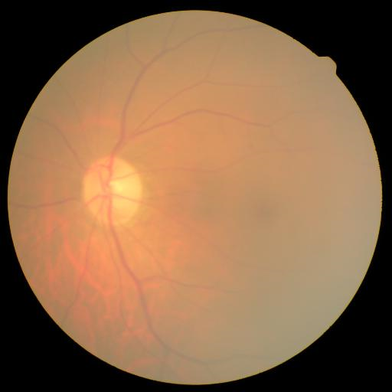
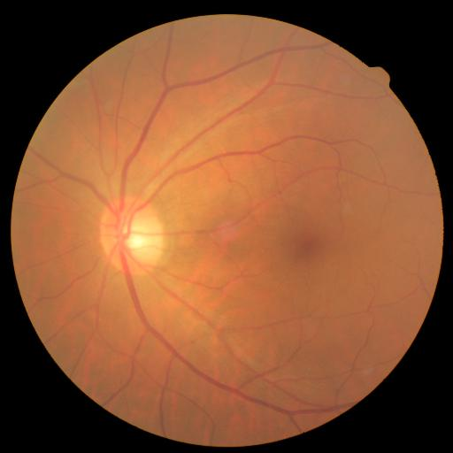
CATARACT VS NORMAL EYE FUNDUS IMAGE
Cataract
Normal Eye

Slide 13
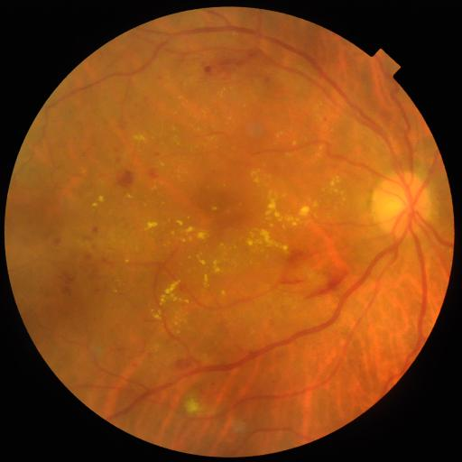
DIABETIC RETINOPATHY VS NORMAL EYE FUNDUS IMAGE
Microaneurysms
Exudates
Hemorrhages
Cotton wool spots
Diabetic
Retinopathy
Normal Eye

Slide 14
When analyzing fundus images for diabetic retinopathy, typically look for specific abnormalities such as:
Microaneurysms: Small bulges in the blood vessels of the retina that can leak
fluid and blood.
Hemorrhages: Areas of bleeding in the retina caused by damaged blood vessels.
Exudates: Deposits of fluid and fat that leak from damaged blood vessels.
Cotton wool spots: Small areas of damaged nerve fibers in the retina that appear
as white spots.
Neovascularization: The growth of new blood vessels in the retina that are
fragile and prone to bleeding.

Slide 15
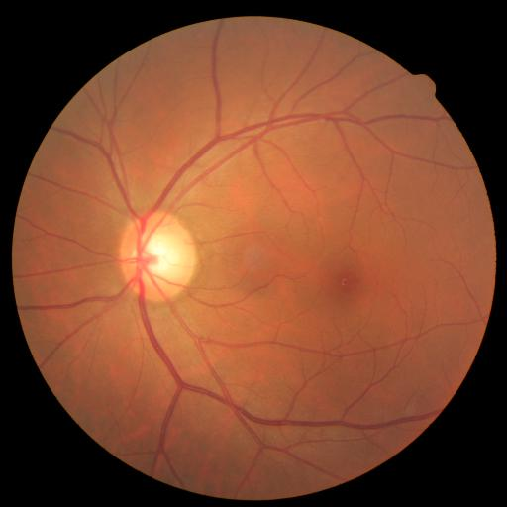
GLAUCOMA VS NORMAL EYE FUNDUS IMAGE
Optic Disk
Optic Cup
Glaucoma
Normal Eye

Slide 16
When examining fundus images for signs of glaucoma, look for several key features. These may include:
Optic nerve head appearance: Changes in the appearance of the optic nerve head, such as the presence of notches, thinning of the nerve fibers, or a pale or white appearance.
Retinal nerve fiber layer thickness: The retinal nerve fiber layer is the layer of nerve fibers that carry visual signals from the retina to the brain. In glaucoma, this layer may become thinner, which can be detected using specialized imaging techniques.

Slide 17
SOFTWARE REQUIREMENTS
Operating System
Integrated Development Environment (IDE)
TensorFlow
Numpy, Pandas, Scikit, Matplotlib, Keras
OpenCV
HTML, CSS, Python
Flask

Slide 18
HARDWARE REQUIREMENTS
CPU (minimum i5 -10th gen)
GPU (minimum RTX 1650)
RAM (minimum 8 GB)
Storage (minimum 250 GB)

Slide 19
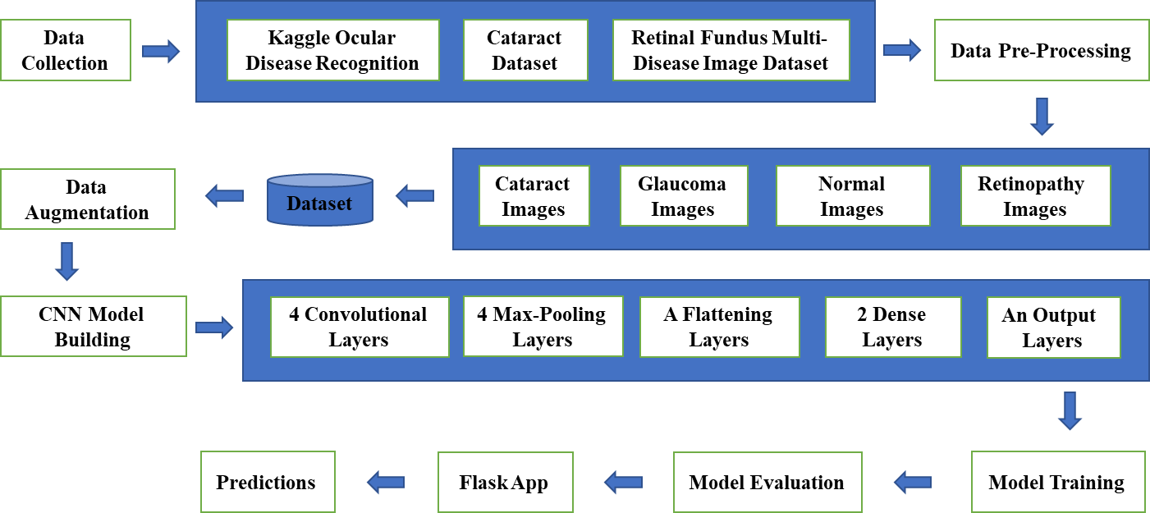
ARCHITECTURE DIAGRAM

Slide 20
NOVELTY
The novelty of this project lies in the application of deep learning to detect ocular diseases in the eyes using images. Ocular disease is a common eye disease that can lead to blindness if not treated on time.
Traditionally, diagnosis of ocular diseases has been done manually by trained medical professionals through visual inspection of the eyes. However, this process is time-consuming and can be subject to errors.
By using deep learning techniques, this project aims to automate the diagnosis process and make it more efficient and accurate. The use of image data and deep learning algorithms allows for the creation of a model that can learn to distinguish between healthy and ocular diseases-affected eyes with high accuracy, reducing the reliance on the manual diagnosis.
This has the potential to significantly improve the speed and accuracy of ocular disease diagnosis, leading to better patient outcomes and potentially reducing the burden on healthcare systems.

Slide 21
MODULES SPLIT UP
MODULE 1: Data Collection Module
MODULE 2: Data Pre-Processing Module
MODULE 3: Image Augmentation Module
MODULE 4: CNN Model Development and Evaluation.
MODULE 5: Web App Development.

Slide 22
MODULE 1: Data Collection Module
Data collection is the process of collecting fundus images with glacoma, cataracts, diabetic retinopathy, and normal eye conditions. These images have been collected from three data sources and preprocessed to fit the CNN model.
Dataset | Description
Kaggle Ocular Disease Recognition | 1560 images mixed
Cataract Dataset | 602 images mixed
RETINAL FUNDUS MULTI-DISEASE IMAGE DATASET | 1780 images mixed
https://www.kaggle.com/andrewmvd/ocular-disease-recognition-odir5k
https://www.kaggle.com/jr2ngb/cataractdataset
https://ieee-dataport.org/open-access/retinal-fundus-multi-disease-image-dataset-rfmid#files

Slide 23
MODULE 1: Data Collection Module
Import necessary libraries: The required libraries for image collection and data handling are imported such as os, shutil, numpy, pandas, and os.path.
Read the CSV file: The CSV file containing information about the images in the dataset is read using pandas library.
Filter data by disease: As the image dataset contains pictures of both diseased and normal eyes, the data is filtered by disease using the str.contains method. This results in new dataframes containing images of each disease - cataract, glaucoma, and diabetic retinopathy.

Slide 24
MODULE 1: Data Collection Module
Move images to respective folders: For each disease, a for loop is used to iterate through the respective dataframes, and the shutil.move method is used to move each image file to the appropriate folder.
Normal images collection: The images of normal eyes are also collected in the same way as above.
Data validation: The data collection process is verified by checking the number of images in each folder, ensuring the collected data is complete and usable.

Slide 25
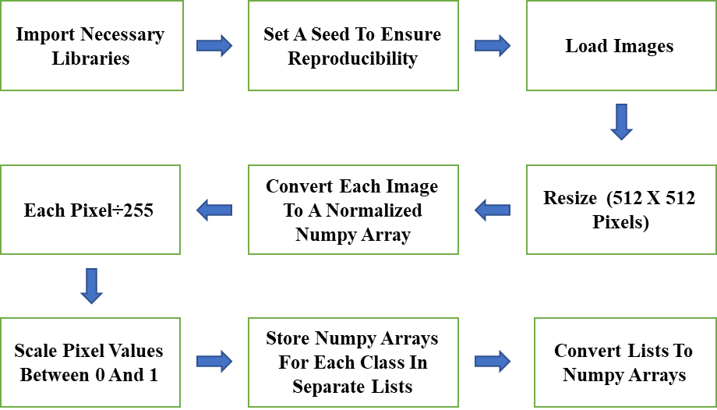
MODULE 2: Data Pre-Processing Module

Slide 26
MODULE 2: Data Pre-Processing Module
The first step is to import the necessary libraries and modules, including matplotlib, numpy, os, pandas, tensorflow, and sklearn.
The OS module is used to access and manipulate file paths and directories.
The numpy module is used for numerical computations on arrays.
The pandas module is used for data manipulation and analysis.
The tensorflow module is used for building and training machine learning models.

Slide 27
MODULE 2: Data Pre-Processing Module
The sklearn module is used for splitting the data into training and testing sets.
To ensure reproducibility, the random seed is set to 42.
The next step is to load and preprocess the images using the load_img and img_to_array functions from tensorflow.keras.preprocessing.image.
The images are loaded from the file directories using os.listdir.
The images are resized to 512x512 pixels using the target_size parameter in load_img.

Slide 28
MODULE 2: Data Pre-Processing Module
Each image is converted to a normalized array using img_to_array and divided by 255 to scale the pixel values between 0 and 1.
The arrays are stored in a list for each class (cataract, cataract_left, and cataract_right).
The list of arrays for each class is converted to a numpy array using np.array.
The shape of each numpy array is checked to ensure that the images have been loaded correctly and have the expected dimensions.

Slide 29
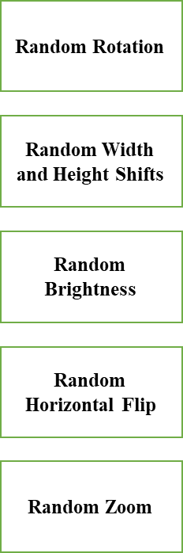
MODULE 3: Image Augmentation Module

Slide 30
MODULE 3: Image Augmentation Module
Random Rotation: Randomly rotate the images by a given degree of rotation to provide the model with variations of the same image. In this project, the degree of rotation is set to 20 degrees.
Random Width and Height Shifts: Randomly shift the width and height of the images by a certain percentage to provide the model with variations of the same image. In this project, the width and height shifts are set to 0.2.

Slide 31
MODULE 3: Image Augmentation Module
Random Brightness: Randomly adjust the brightness of the images to provide the model with variations of the same image. In this project, the brightness range is set to 0.5 to 1.5.
Random Horizontal Flip: Randomly flip the images horizontally to provide the model with variations of the same image.
Random Zoom: Randomly zoom into the images by a certain percentage to provide the model with variations of the same image. In this project, the zoom range is set to 0.2.

Slide 32
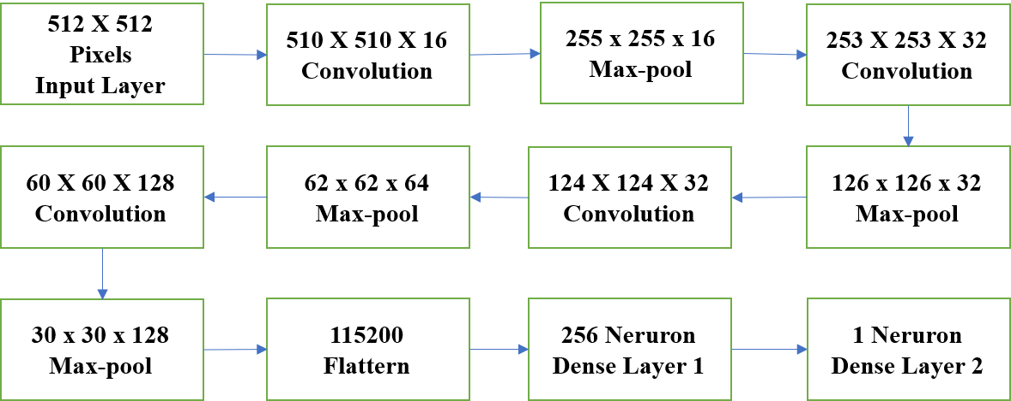
MODULE 4: CNN Model Development and Evaluation
CNN Architecture

Slide 33
MODULE 4: CNN Model Development and Evaluation.
Input layer: Takes in images of size 512 x 512 pixels with 3 color channels (RGB).
Convolutional layer 1: Applies 16 filters of size 3 x 3 to detect image features. The output size is 510 x 510 x 16.
Max pooling layer 1: Reduces the size of the output from the previous layer by taking the maximum value in every 2 x 2 grid. The output size is 255 x 255 x 16.
Convolutional layer 2: Applies 32 filters of size 3 x 3 to detect more complex image features. The output size is 253 x 253 x 32.

Slide 34
MODULE 4: CNN Model Development and Evaluation.
Max pooling layer 2: Reduces the size of the output from the previous layer. The output size is 126 x 126 x 32.
Convolutional layer 3: Applies 64 filters of size 3 x 3 to detect even more complex image features. The output size is 124 x 124 x 64.
Max pooling layer 3: Reduces the size of the output from the previous layer. The output size is 62 x 62 x 64.Convolutional layer 4: Applies 128 filters of size 3 x 3 to detect even more complex image features. The output size is 60 x 60 x 128.

Slide 35
MODULE 4: CNN Model Development and Evaluation.
Max pooling layer 4: Reduces the size of the output from the previous layer. The output size is 30 x 30 x 128.Flatten layer: Flattens the output from the previous layer into a 1D array. The output size is 115200.
Dense layer 1: Applies 256 neurons with ReLU activation function to learn the features from the flattened output. The output size is 256.
Dropout layer: Prevents overfitting by randomly dropping out some of the neurons. The output size is still 256.
Dense layer 2: Applies 1 neuron with sigmoid activation function to make binary classification between the presence and absence of the disease.

Slide 36
MODULE 5: Web App Development
Frontend: The frontend of the Flask app can be built using HTML, CSS, and JavaScript. The user interface can include a form where the user can upload an image file. On submission of the form, an AJAX request can be sent to the Flask backend to process the image and provide the prediction.
Backend: The backend of the Flask app can use the trained fundus image classification model to make a prediction on the input image.

Slide 37
MODULE 5: Web App Development
The backend can include the following components:
A pre-processing module to resize the input image to the required size and convert it to a suitable format for the model input. The trained model to make a prediction on the preprocessed image. A post-processing module to interpret the model output and generate a response to the user.

Slide 38
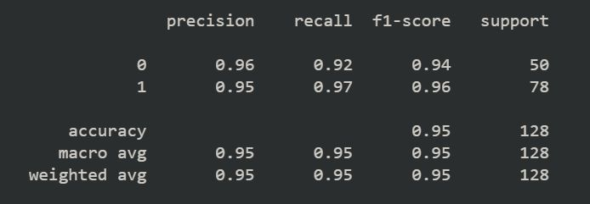
RESULTS
CATARACT DETECTION MODEL

Slide 39
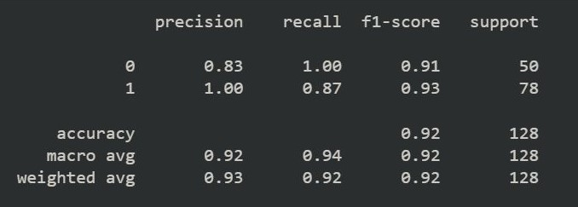
DIABETIC RETINOPATHY DETECTION MODEL

Slide 40
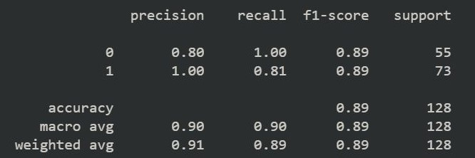
GLACOMA DETECTION MODEL

Slide 41
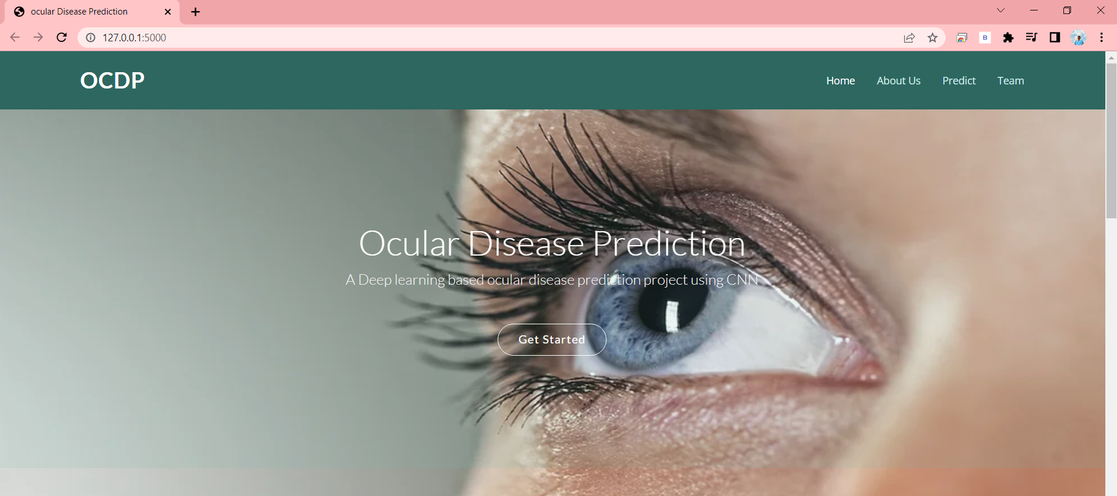
SAMPLE SCREENSHOT
Web application home page

Slide 42
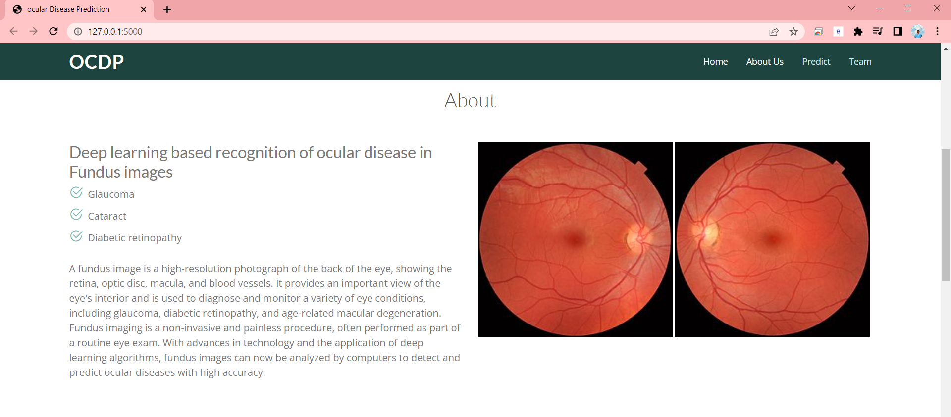
Web application About page

Slide 43
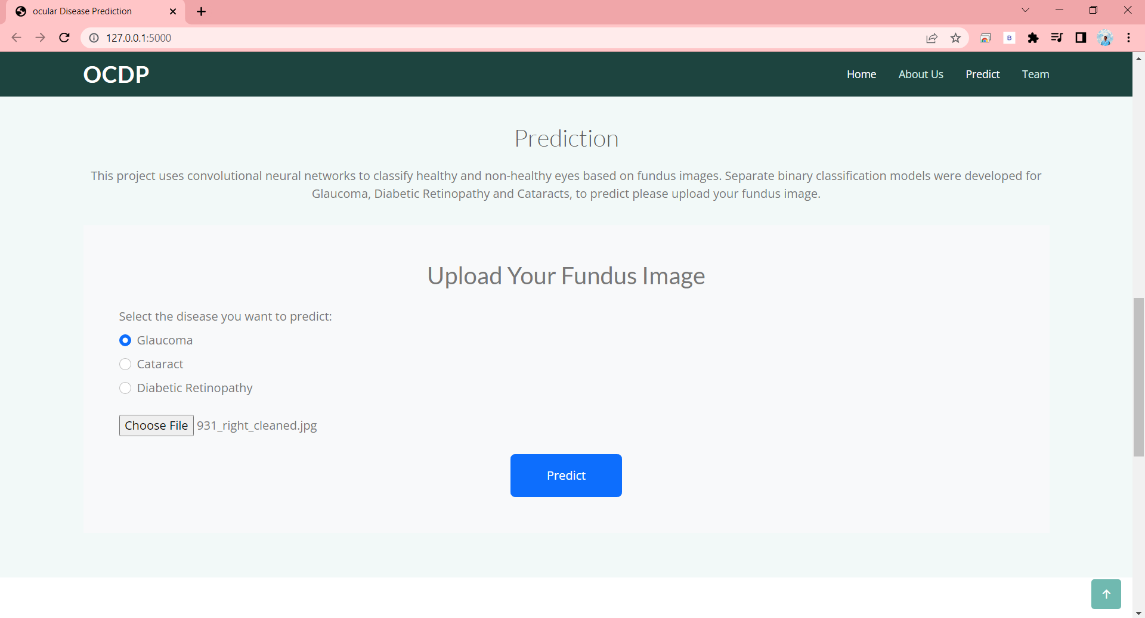
Selecting and uploading Glaucoma fundus image

Slide 44
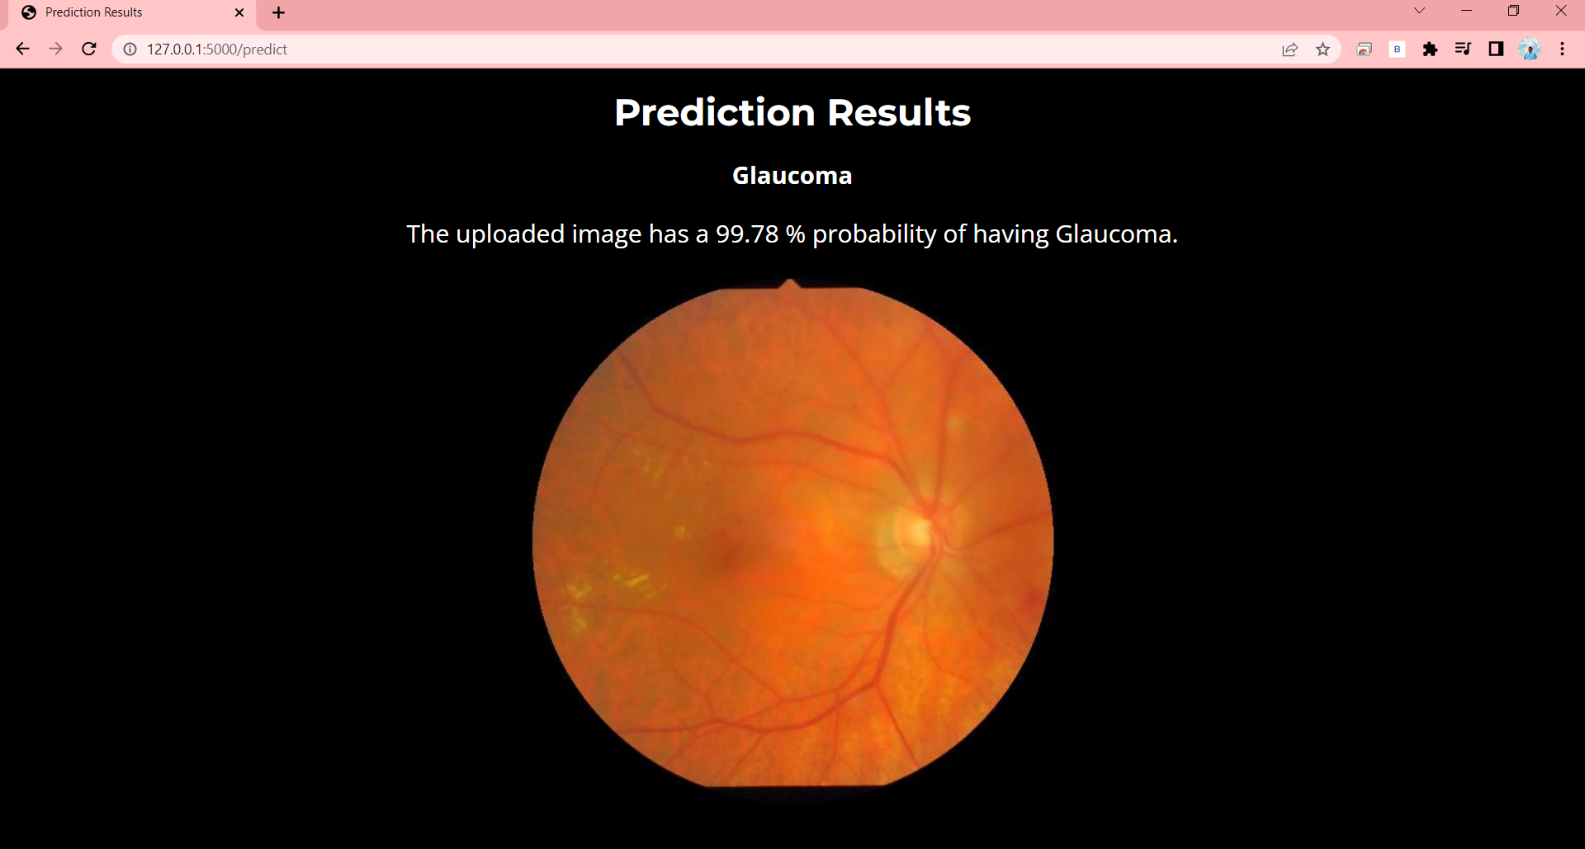
Prediction Result of Glaucoma Fundus image

Slide 45
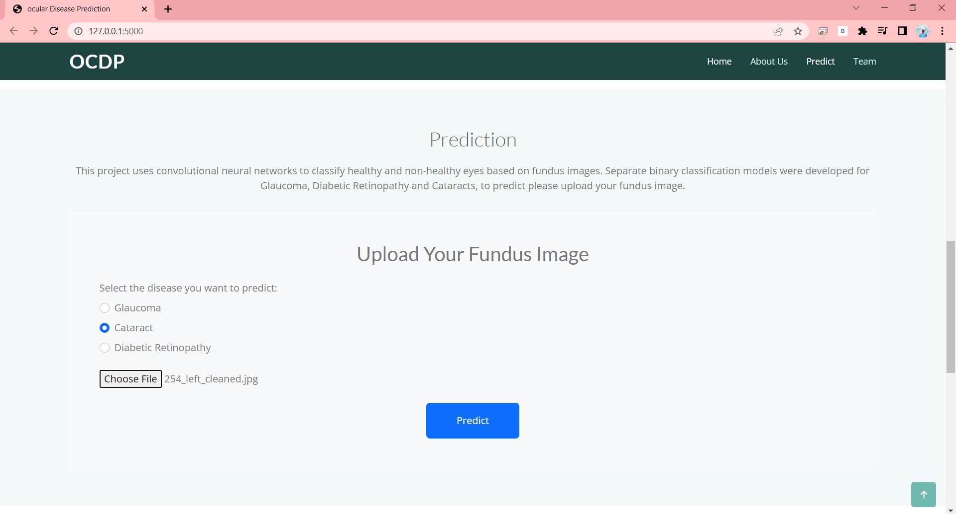
Selecting and uploading Cataract fundus image

Slide 46
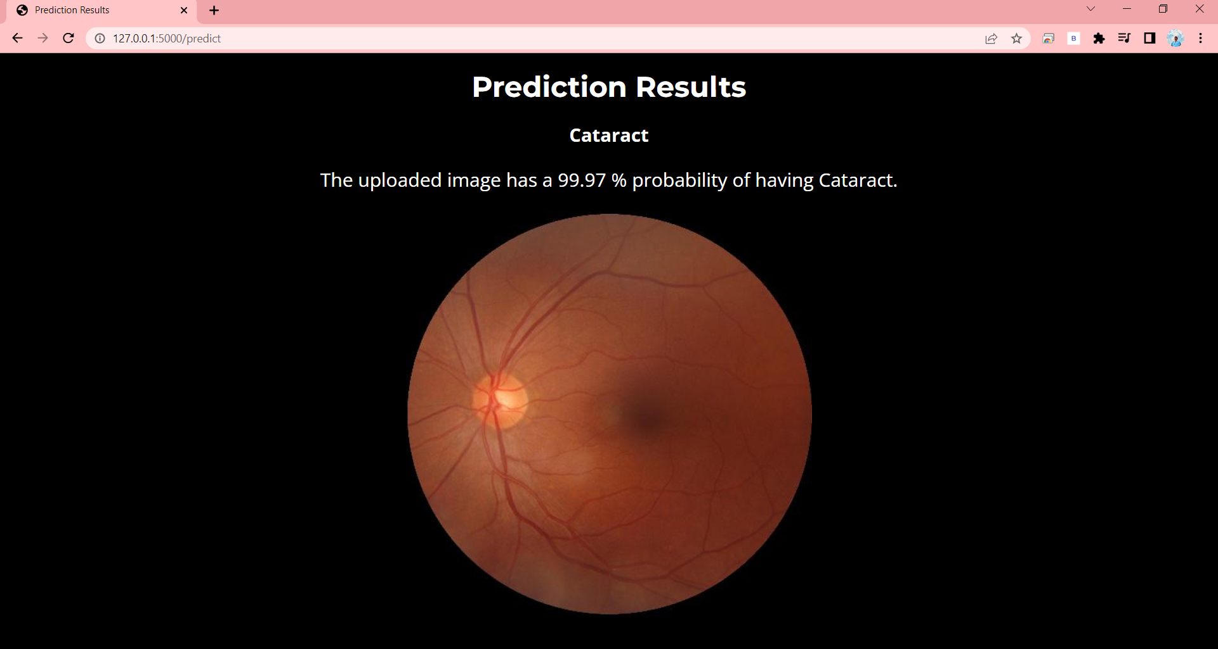
Prediction Result of Cataract Fundus image

Slide 47
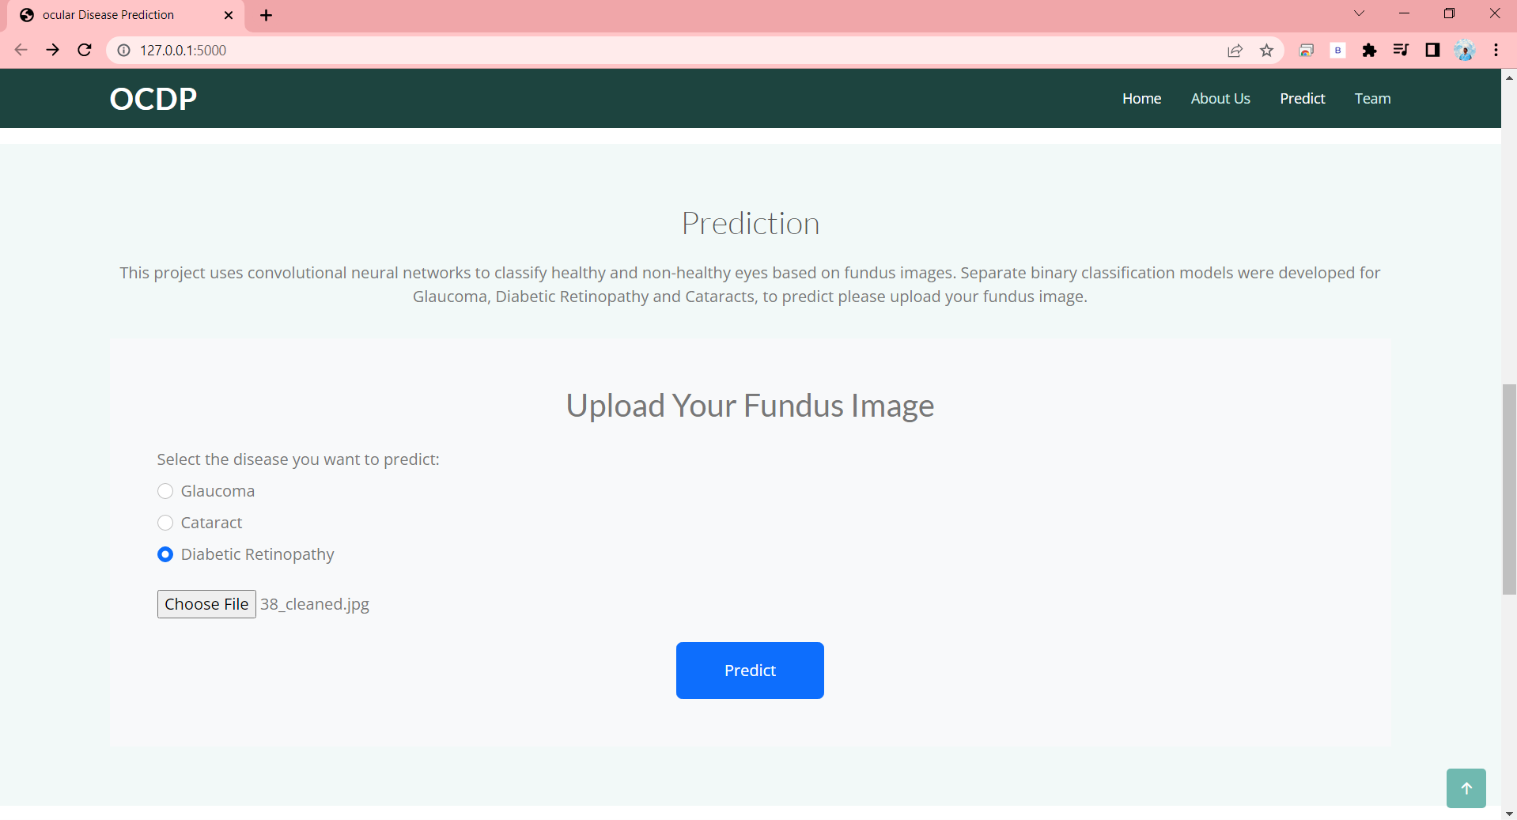
Selecting and uploading Diabetic retinopathy fundus image

Slide 48
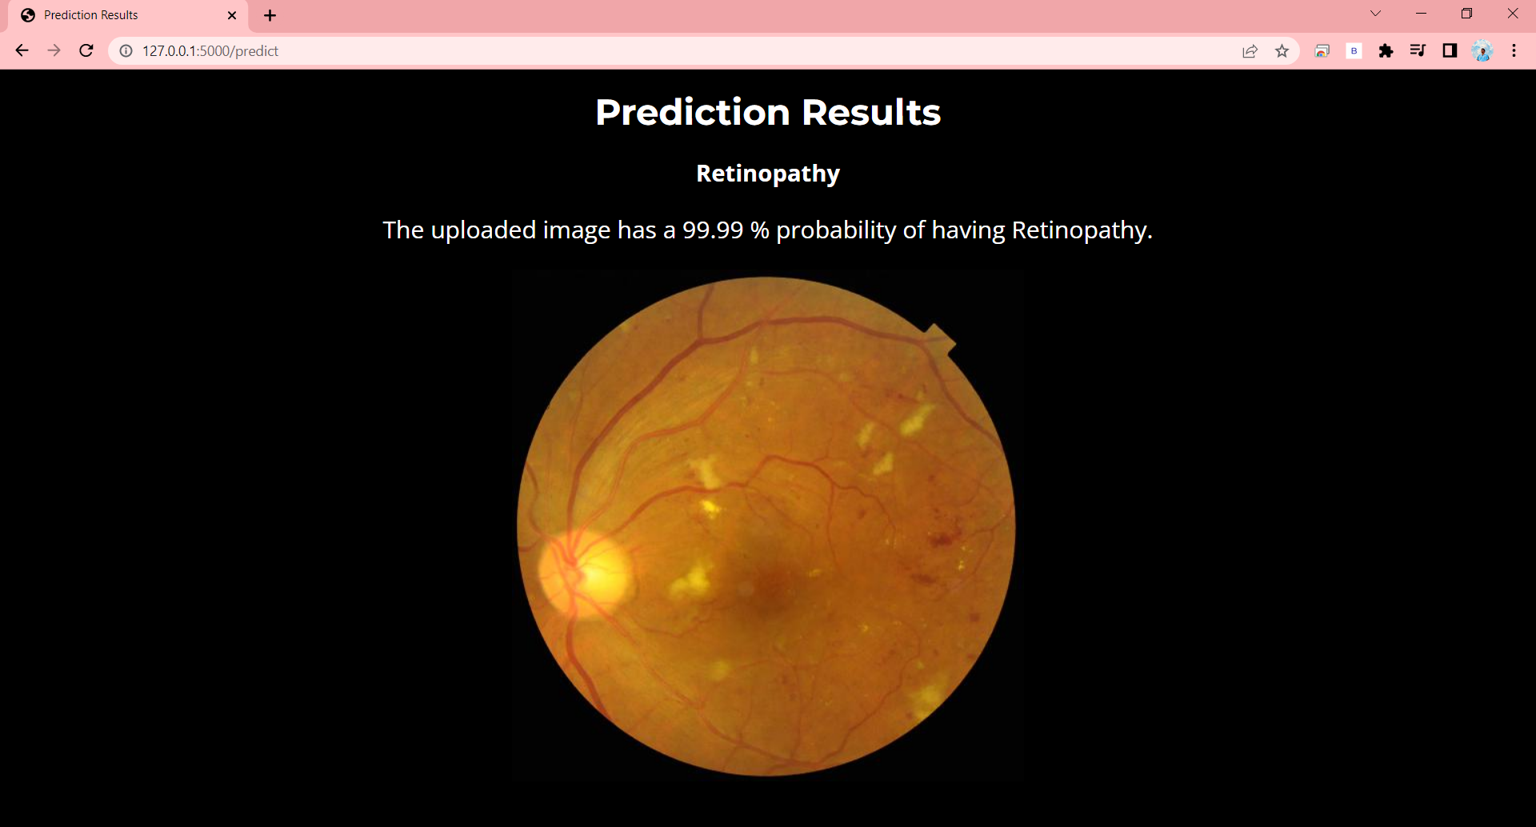
Prediction Result of Diabetic Retinopathy Fundus image

Slide 49
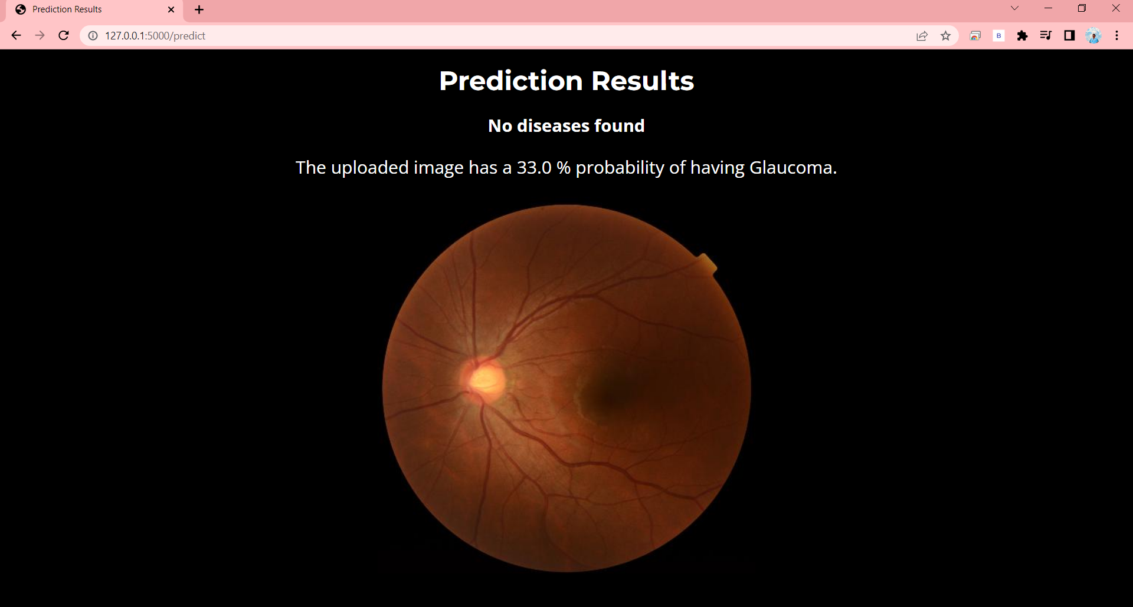
Prediction Result of Normal eye Fundus image

Slide 50
SAMPLE CODING
Index.html
<!DOCTYPE html>
<html lang="en">
<head>
<meta charset="utf-8">
<meta content="width=device-width, initial-scale=1.0" name="viewport">
<title>ocular Disease Prediction</title>
<meta content="" name="description">
<meta content="" name="keywords">
<!-- Google Fonts -->
<link href="https://fonts.googleapis.com/css?family=Open+Sans:300,300i,400,400i,600,600i,700,700i|Lato:400,300,700,900" rel="stylesheet">
<!-- Vendor CSS Files -->
<link href="static/assets/vendor/bootstrap/css/bootstrap.min.css" rel="stylesheet">
<link href="static/assets/vendor/bootstrap-icons/bootstrap-icons.css" rel="stylesheet">
<link href="static/assets/vendor/glightbox/css/glightbox.min.css" rel="stylesheet">

Slide 51
<link href="static/assets/vendor/swiper/swiper-bundle.min.css" rel="stylesheet">
<!-- Template Main CSS File -->
<link href="static/assets/css/style.css" rel="stylesheet">
</head>
<body>
<!-- ======= Header ======= -->
<header id="header" class="fixed-top d-flex align-items-center">
<div class="container d-flex align-items-center">
<div class="logo me-auto">
<h1><a href="index.html">OCDP</a></h1>
</div>
<nav id="navbar" class="navbar">
<ul>
<li><a class="nav-link scrollto active" href="#index.html">Home</a></li>
<li><a class="nav-link scrollto" href="#about">About Us</a></li>
<li><a class="nav-link scrollto" href="#services">Predict</a></li>
<li><a class="nav-link scrollto" href="#team">Team</a></li>
</ul>

Slide 52
<i class="bi bi-list mobile-nav-toggle"></i>
</nav><!-- .navbar -->
</div>
</header><!-- End #header -->
<!-- ======= Hero Section ======= -->
<section id="hero">
<div class="hero-container">
<img src="https://static.wixstatic.com/media/84770f_354d7d9db0344028a08a2a46f2bf82cc~mv2_d_3501_2554_s_4_2.jpg/v1/fill/w_980,h_436,al_c,q_85,usm_0.66_1.00_0.01,enc_auto/84770f_354d7d9db0344028a08a2a46f2bf82cc~mv2_d_3501_2554_s_4_2.jpg" class="eye"/>
<h1>Ocular Disease Prediction</h1>
<h2>A Deep learning based ocular disease prediction proposed system using CNN</h2>
<a href="#services" class="btn-get-started scrollto">Get Started</a>
</div>
</section><!-- #hero -->

Slide 53
<main id="main">
<!-- ======= About Us Section ======= -->
<!-- ======= About Us Section ======= -->
<section id="about" class="about">
<div class="container">
<div class="section-title">
<h2>About </h2>
</div>
<div class="row">
<div class="col-lg-6 order-1 order-lg-2">
<img src="static/assets/img/Eye.jpg" class="img-fluid" alt="" width="315" height="315">
<img src="static/assets/img/Eye2.jpg" class="img-fluid" alt="" width="315" height="315">
</div>
<div class="col-lg-6 pt-4 pt-lg-0 order-2 order-lg-1">
<h3>Deep learning based recognition of ocular disease in Fundus images </h3>
<ul>

Slide 54
<li><i class="bi bi-check2-circle"></i> Glaucoma </li>
<li><i class="bi bi-check2-circle"></i> Cataract </li>
<li><i class="bi bi-check2-circle"></i> Diabetic retinopathy </li>
</ul>
<p>A fundus image is a high-resolution photograph of the back of the eye, showing the retina, optic disc, macula, and blood vessels. It provides an important view of the eye's interior and is used to diagnose and monitor a variety of eye conditions, including glaucoma, diabetic retinopathy, and age-related macular degeneration. Fundus imaging is a non-invasive and painless procedure, often performed as part of a routine eye exam. With advances in technology and the application of deep learning algorithms, fundus images can now be analyzed by computers to detect and predict ocular diseases with high accuracy.</p>
</div>
</div>
</div>
</section><!-- End About Us Section -->
<!-- ======= Services Section ======= -->
<section id="services" class="services section-bg">

Slide 55
<div class="container">
<div class="section-title">
<h2>Prediction</h2>
<p>This proposed system uses convolutional neural networks to classify healthy and non-healthy eyes based on fundus images. Separate binary classification models were developed for Glaucoma, Diabetic Retinopathy and Cataracts, to predict please upload your fundus image.</p>
</div>
<form action="{{ url_for('predict_disease') }}" method="post" enctype="multipart/form-data" class="p-5 bg-light">
<h2 class="mb-4 text-center">Upload Your Fundus Image</h2>
<div class="form-group mb-4">
<label for="diseaseSelect">Select the disease you want to predict:</label>
<div class="form-check mt-2">
<input class="form-check-input" type="radio" name="disease" id="glaucomaRadio" value="glaucoma">
<label class="form-check-label" for="glaucomaRadio">Glaucoma</label>
</div>

Slide 56
<div class="form-check mt-2">
<input class="form-check-input" type="radio" name="disease" id="cataractRadio" value="cataract">
<label class="form-check-label" for="cataractRadio">Cataract</label>
</div>
<div class="form-check mt-2">
<input class="form-check-input" type="radio" name="disease" id="retinopathyRadio" value="retinopathy">
<label class="form-check-label" for="retinopathyRadio">Diabetic Retinopathy</label>
</div>
</div>
<div class="form-group">
<div class="custom-file">
<input type="file" class="custom-file-input" id="imageUpload" name="file">
<label class="custom-file-label" for="imageUpload"></label>
</div>
<div class="mt-2">

Slide 57
<span id="image-name"></span>
</div>
</div>
<div class="text-center mt-4">
<button type="submit" class="btn btn-primary px-5 py-3">Predict</button>
</div>
</form>
</div>
</section><!-- End Services Section -->
<!-- ======= Our Team Section ======= -->
<!-- ======= Our Team Section ======= -->
<section id="team" class="team">
<div class="container">
<div class="section-title">
<h2>Our Team</h2>
<p>Our group has a keen interest in leveraging deep learning techniques for the accurate and early detection of ocular diseases. Through our research, we aim to develop a reliable deep learning model that can predict diseases such as glaucoma, cataract, and diabetic retinopathy with high accuracy</p>

Slide 58
</div>
<div class="row gy-4">
<div class="col-lg-4 col-md-6">
<div class="member">
<img src="static/assets/img/team/Raj.jpg" alt="">
<h4>Raj Kumar</h4>
<span>211419205136</span>
<p>
Student at Panimalar Engineering College
</p>
</div>
</div>
<div class="col-lg-4 col-md-6">
<div class="member">
<img src="static/assets/img/team/Vettri.jpg" alt="">
<h4>Vettri Chezhian</h4>
<span>211419205175</span>
<p>

Slide 59
Student at Panimalar Engineering College
</p>
</div>
</div>
<div class="col-lg-4 col-md-6">
<div class="member">
<img src="static/assets/img/team/Nithish.jpg" alt="">
<h4>Nithish Kumar</h4>
<span>211419205119</span>
<p>
Student at Panimalar Engineering College
</p>
</div>
</div>
</div>
</div>
</section><!-- End Our Team Section -->
</main><!-- End #main -->

Slide 60
<!-- ======= Footer ======= -->
<footer id="footer">
<div class="container">
<div class="copyright">
&copy; Copyright <strong><span>OCDP</span></strong>. All Rights Reserved
</div>
<div class="credits">
<!-- All the links in the footer should remain intact. -->
<!-- You can delete the links only if you purchased the pro version. -->
<!-- Licensing information: https://bootstrapmade.com/license/ -->
<!-- Purchase the pro version with working PHP/AJAX contact form: https://bootstrapmade.com/free-one-page-bootstrap-template-amoeba/ -->
Done by Batch 12
</div>
</div>
</footer><!-- End #footer -->
<a href="#" class="back-to-top d-flex align-items-center justify-content-center"><i class="bi bi-arrow-up-short"></i></a>

Slide 61
<!-- Vendor JS Files -->
<script src="static/assets/vendor/bootstrap/js/bootstrap.bundle.min.js"></script>
<script src="static/assets/vendor/glightbox/js/glightbox.min.js"></script>
<script src="static/assets/vendor/isotope-layout/isotope.pkgd.min.js"></script>
<script src="static/assets/vendor/swiper/swiper-bundle.min.js"></script>
<script src="static/assets/vendor/php-email-form/validate.js"></script>
<!-- Template Main JS File -->
<script src="static/assets/js/main.js"></script>
</body>
</html>

Slide 62
App.py
from flask import Flask, render_template, request
import os
from tensorflow.keras.preprocessing import image
import numpy as np
import tensorflow as tf
from werkzeug.utils import secure_filename
app = Flask(__name__)
# Load the saved models
glaucoma_model = tf.keras.models.load_model('glaucoma_model.h5')
cataract_model = tf.keras.models.load_model('cataract_model.h5')
diabetic_retinopathy_model = tf.keras.models.load_model('retinopathy_model.h5')
# Define the allowed file extensions for uploaded images
ALLOWED_EXTENSIONS = {'png', 'jpg', 'jpeg'}
def allowed_file(filename):
"""Check if a file has an allowed extension"""
return '.' in filename and filename.rsplit('.', 1)[1].lower() in ALLOWED_EXTENSIONS
def predict(image_path, model):

Slide 63
"""Make a prediction on a fundus image using a given model"""
img = tf.keras.preprocessing.image.load_img(image_path, target_size=(512, 512))
x = image.img_to_array(img)
x = x / 255.0
x = np.expand_dims(x, axis=0)
preds = model.predict(x)
return preds[0][0]
@app.route('/')
def index():
"""Render the index page"""
return render_template('index.html')
@app.route('/predict', methods=['POST'])
def predict_disease():
"""Make a prediction on an uploaded fundus image"""
# Get the uploaded file
file = request.files['file']
# Check if file is empty
if not file:

Slide 64
return render_template('index.html', message='No file was uploaded.')
# Check if the file has an allowed extension
if not allowed_file(file.filename):
return render_template('index.html', message='Invalid file type. Only PNG and JPEG files are allowed.')
# Save the file to the uploads folder
filename = secure_filename(file.filename)
file_path = os.path.join('static/uploads', filename)
file.save(file_path)
# Determine which model to use based on user input
model = None
disease = request.form.get('disease')
print(disease)
if disease == 'glaucoma':
model = glaucoma_model
elif disease == 'cataract':
model = cataract_model
elif disease == 'retinopathy':

Slide 65
model = diabetic_retinopathy_model
# Make a prediction using the selected model
if model:
preds = predict(file_path, model)
if preds < 0.9:
disease_found = disease
disease = "No Diseases Found"
else:
disease_found = disease
predicted = preds * 100
predicted_prob = round(predicted, 2)
return render_template('result.html', preds=predicted_prob, disease=disease, disease_found=disease_found, filename=filename)
else:
return render_template('index.html', message='Invalid disease selected.')
if __name__ == '__main__':
app.run(debug=True)

Slide 66
PROJECT WORK FLOW
Task | Start Date | End Date | Duration
Requirements gathering and analysis | 25/01/2023 | 05/02/2023 | 10 days
Design and architecture planning | 06/02/2023 | 12/02/2023 | 7 days
Development and coding | 13/02/2023 | 15/03/2023 | 31 days
Testing and debugging | 16/03/2023 | 22/03/2023 | 7 days
Documentation and final review | 23/03/2023 | 27/03/2023 | 5 days

Slide 67
REFERENCES
T. Guergueb and M. A. Akhloufi. (2021). “Ocular diseases detection using recent deep learning techniques”, in Proceedings of the Annual Int. Conf. IEEE Eng Med Biol Soc, pp. 3336–3339, IEEE, Mexico.
Caroline Ka Lin Chee, Patrick A. Santiago, Gopal Lingam, Mandeep Singh. (2014). “Application of Ocular Fundus Photography and Angiography”, Ophthalmological Imaging and Applications,154–175. https://doi.org/10.1201/b17026-12%20.
Y. Elloumi, M. Akil, and H. Boudegga. (2019). “Ocular diseases diagnosis in fundus images using a deep learning: approaches, tools and performance evaluation,” in Proc. Real-Time Image Processing and Deep learning. 109960T, Maryland, USA.
Borgen, P. Bours, and S. D. Wolthusen. (2009) “Simulating the Influences of Aging and Ocular Disease on Biometric Recognition Performance,” International Conference on Biometrics 2009, LNCS 5558, vol. 8(8),pp. 857–867.

Slide 68
Li, N., Li, T., Hu, C., Wang, K., & Kang, H. (2021). “A Benchmark of Ocular Disease Intelligent Recognition: One Shot for Multi-disease Detection. Benchmarking, Measuring, and Optimizing”, 177–193. https://doi.org/10.1007/978-3-030-71058-3_11.
Miranda, E., Aryuni, M., & Irwansyah, E. (2016). “A survey of medical image classification techniques”, In 2016 International Conference on Information Management and Technology (ICIMTech) (pp. 56-61). IEEE.
Li, Z., He, Y., Keel, S., Meng, W., Chang, R. T., He, M. (2018). “Efficacy of a Deep learning System for Detecting Glaucomatous Optic Neu-ropathy Based on Color Fundus Photographs. Ophthalmology”, 125(8), 1199–1206. https://doi.org/10.1016/j.ophtha.2018.01.023.
Playout, C., Duval, R., Cheriet, F. (2019). “A Novel Weakly Supervised Multitask Architecture for Retinal Lesions Segmentation on Fundus”.
K. M. Noaman, A. Arafat, and I. A. Alqubati. (2014) “Diagnosis of Poor Eyesight based on Support Vector Machine and Artificial Neural Networks”, Journal of Emerging Trends in Computing and Information Sciences.

Slide 69
MD Abr`amoff, MK Garvin, M Sonka. (2014) “Retinal imaging and image analysis,” IEEE reviews in biomedical engineering, vol. 3, pp. 169-208.
Carson Lam, Darvin Yi, Margaret Guo, and Tony Lindsey. (2018). “Automated detection of diabetic retinopathy using deep learning,” AMIA Summits on Translational Science Proceedings 2018, pp. 147-155.
Fu H., Cheng J., Xu Y., Zhang C., Wong D. W. K., Liu J., Cao X. (2018). “Disc-Aware Ensemble Network for Glaucoma Screening from Fundus Image,” IEEE Trans. Med. Imaging 37(11), pp. 2493-2501.
Tan, J.H., Bhandary, S.V., Sivaprasad, S., Hagiwara, Y., Bagchi, A., Raghavendra, U., Rao, A.K., Raju, B., Shetty, N.S., Gertych, A., et al. (2018). “Age-related macular degeneration detection using deep convolutional neural network”, Future Generation Computer Systems 87, 127–135.
Decenci`ere, E., Cazuguel, G., Zhang, X., Thibault, G., Klein, J.C., Meyer, F., Marcotegui, B., Quellec, G., Lamard, M., Danno, R., et al. (2013). “Teleophta: Machine learning and image processing methods for teleophthalmology”. Irbm 34(2), 196–203.

Slide 70
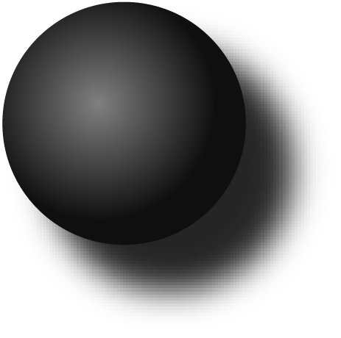
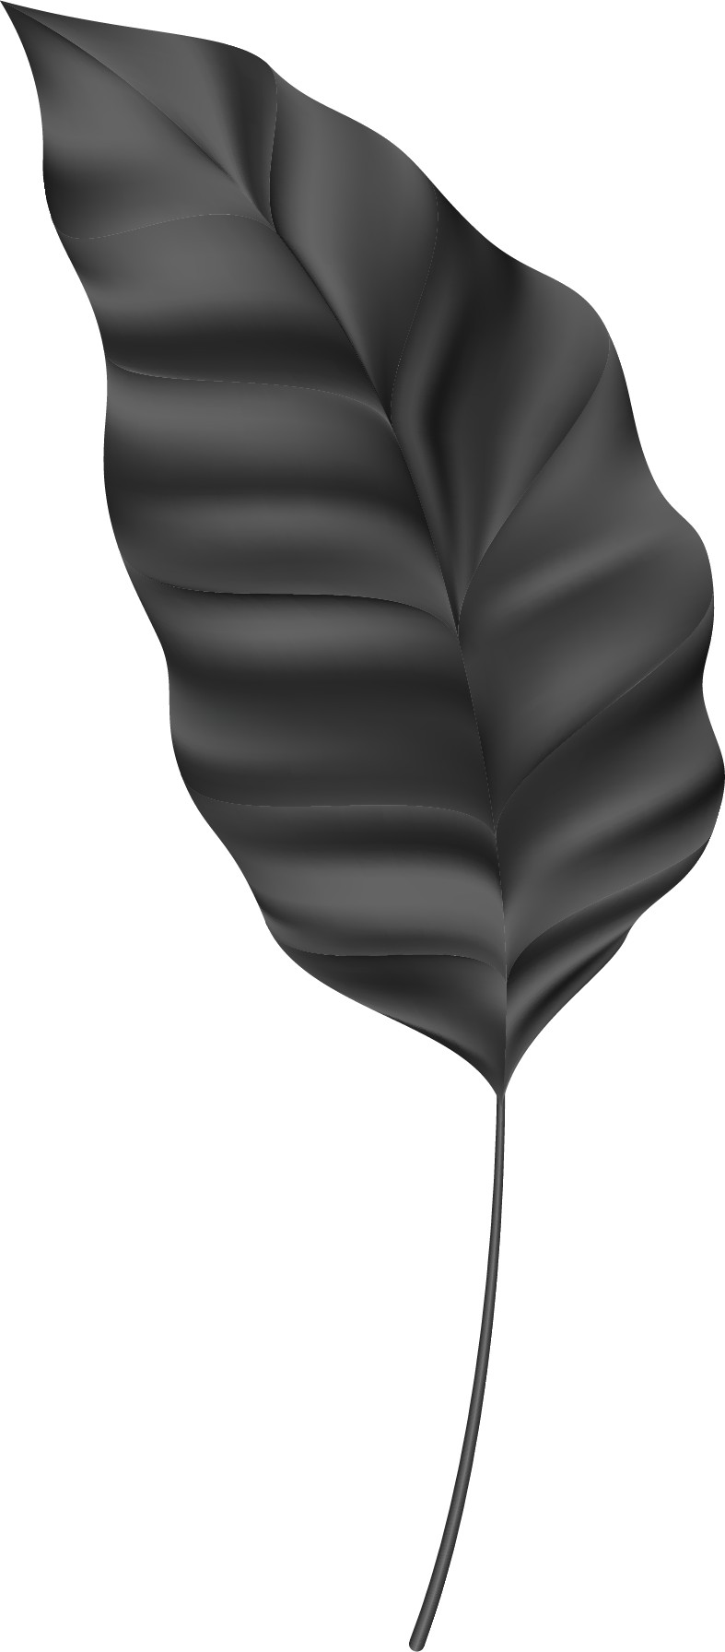
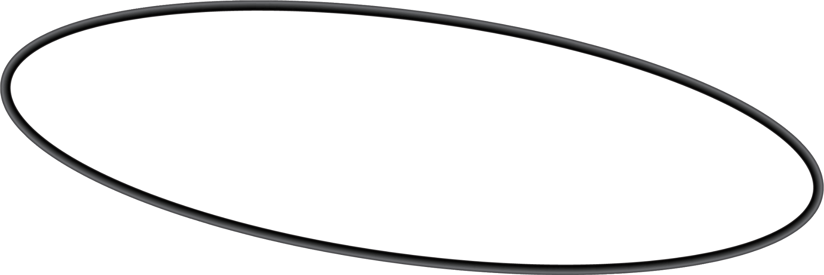

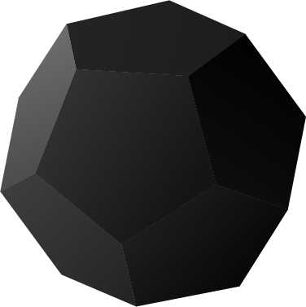
THANK YOU

